Slide 1
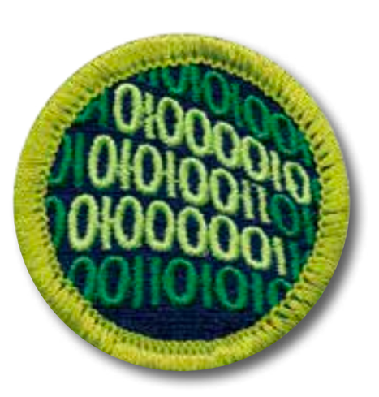
Programming Merit Badge
February 1, 2020 – 9am
Jean-Etienne Poirrier
jepoirrier@gmail.com
This presentation (except parts taken from other, referenced work) is licensed under a Creative Common Attribution-ShareAlike 4.0 International License
Notes:
Ask who already programmed – just to gauge the audience

Slide 2
What will be seen today?
Safety
History of programming
Programming today
Intellectual property
Careers
And we’ll program a little bit!
Did anyone want to present?
Notes:
1. Safety: people has died playing a long time on their computer – but even if you spend less time than them, you still risk a few injuries …
Then we’ll stop to check how we sit
2. History - Then we’ll stop to connect laptops, check Python, etc.
3. Programming – Then we’ll stop to actually program a little bit!
4. IP
6. Careers
They can take note but I will give them all the slides (maybe print them so they can see for themselves)

Slide 3
What will NOT be seen today?
A lot!
Because programming exists since at least 50-100 years (since computers existed – approximately)
But if you have any question (on topics seen here or on anything else related to programming), let me know and I’ll try my best to answer!
(also, Stack Overflow probably has the answer to most questions! https://stackoverflow.com/questions)

Slide 4
Why me?
Jean-Etienne “Jep” Poirrier
Biologist by training, working in the pharmaceutical industry, building health economics models for vaccines
B.Sc. in computer sciences
Wrote a few Open Source software
Wrote 1 scientific paper demonstrating the usefulness of a software I co-created
Wrote dozens of articles about Linux and other Open Source software

Slide 5
And why you? ☺
Bobby A.
Charles B.
Daniel C.
Sam D.
Tyson E.
Alexander F.
Arijeet G.

Slide 6
And so? What is programming?
Programming is the act of inserting instructions into a computer or machine to be followed.
There are many different career fields involving the programming of computers; each utilizing different languages, techniques, and systems.
We are only going to cover a few of the different aspects of programming during this Merit Badge, but there are so many more.

Slide 7
Programming is converting ideas into instructions
Understand the purpose of the program (requirements)
Break instructions into steps (design)
Translate design into language (coding)
Verify actual results match expected results (testing)

Slide 8
1. Safety

Slide 9
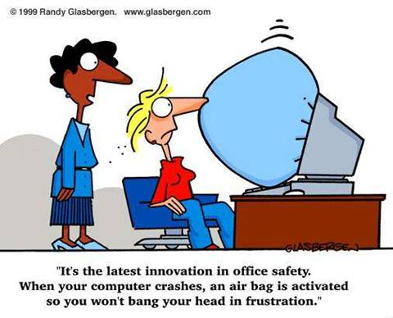

Slide 10


Slide 11
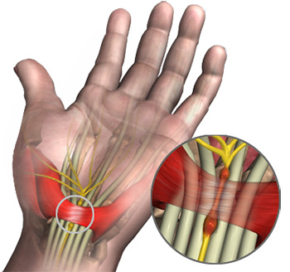
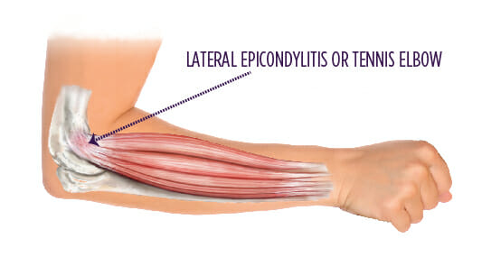
RSIs - Repetitive Stress Injuries
Carpal tunnel syndrome
Cervical radiculopathy
Reflex sympathetic dystrophy
Tendonitis

Slide 12
First Aid for RSIs
Apply an ice pack to the injured area to help reduce pain and swelling
Use an elastic joint support or wrap the area firmly with an elastic bandage to limit the swelling and to protect the injury. Do not wrap it so tightly that blood circulation is restricted!
Rest the injured area
Take an anti-inflammatory pain reliever as recommended by your physician
After 24 hours, heat (hot packs, heating pad, whirlpool) may be applied
As symptoms diminish, gently exercise the affected muscles or joints to help relieve remaining tenderness, stiffness, and tingling or numbness
If pain is severe or persistent, seek medical attention

Slide 13

Injury prevention
Proper equipment (+ ergonomics)
HYDRATION
Soda, juices and other sweet drinks are not a substitute for water
Program in a well-lit room (prevent eyestrain)
Minimize the contrast between your monitor and the rest of the room
Make sure there is no glare on the screen
Take breaks to give your body time to recover

Slide 14

Take breaks
Eye breaks
Look away from the monitor from time to time, preferably at something more than 20 feet away. This gives your eyes a chance to relax and helps prevent eyestrain.
Typing breaks
Rest your hands in a relaxed, flat, straight manner to give them time to recover and prevent RSIs
Rest breaks
Take a break every 30 minutes or so to give your body a chance to relax. You can use software programs that remind you to take a break so you don’t get stuck in a trance staring at your monitor
Exercise breaks
Get up and stretch, rotate your head and shoulders, move your arms and legs.
You will find that you can program better and longer if you do this regularly

Slide 15
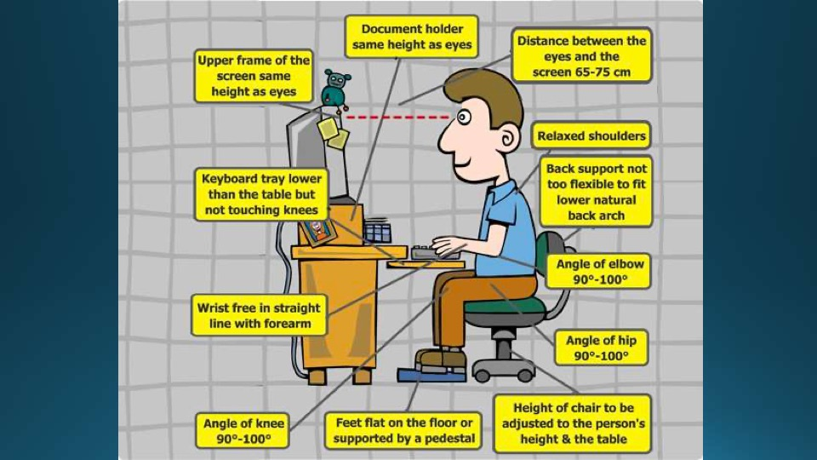
Ergonomics
65cm = 25.6 in
75cm = 29.5 in
Notes:
Image from Eric Silva, Hawk Mountain Council, STEM Day 2016

Slide 16
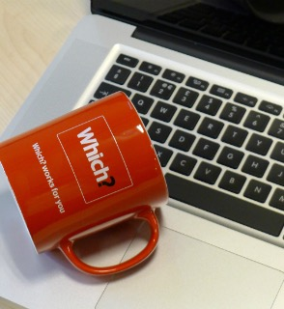
Electrical safety
Keep liquid and food away from plugged-in machines
Be sure the equipment is properly grounded to prevent shock hazards
It’s best to unplug the computer when it’s not in use, especially during a thunderstorm
Make sure any cords are neatly stowed to prevent tripping

Slide 17
Additional pointers
Computer-Related Repetitive Stress Injuries (Johns Hopkins): https://www.hopkinsallchildrens.org/Patients-Families/Health-Library/HealthDocNew/Computer-Related-Repetitive-Stress-Injuries
12 tips for an Ergonomic Computer Workstation (Cornell University): http://ergo.human.cornell.edu/DEA6510/dea6512k/ergo12tips.html
25 Ergonomic Tips For Students When Working At A Computer (Vista College): https://www.vistacollege.edu/blog/resources/25-ergonomic-tips-when-working-at-a-computer/

Slide 18
1. Safety
Now you can answer Requirements 1a And 1b!

Slide 19
2. History of programming

Slide 20
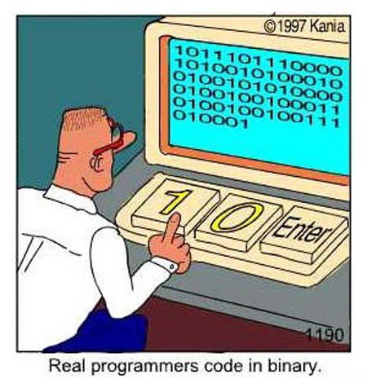

Slide 21
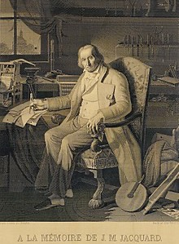
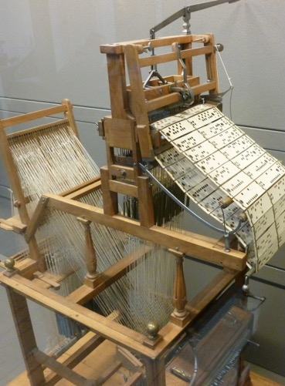
Before computers
Before the modern electrical computer, mechanical devices used in factories were the first machines to be programmed.
An example is the Joseph Jacquard Loom (1804) which used hole-punched cards to “program” patterns into fabric.
The picture on the left is the loom.
The picture on the right is a portrait of Jacquard was woven in silk on a Jacquard loom and required 24,000 punched cards to create (1839). One of these portraits in the possession of Charles Babbage inspired him in using perforated cards in his Difference Engine.
Notes:
Adapted from Robert Baker, 2018

Slide 22
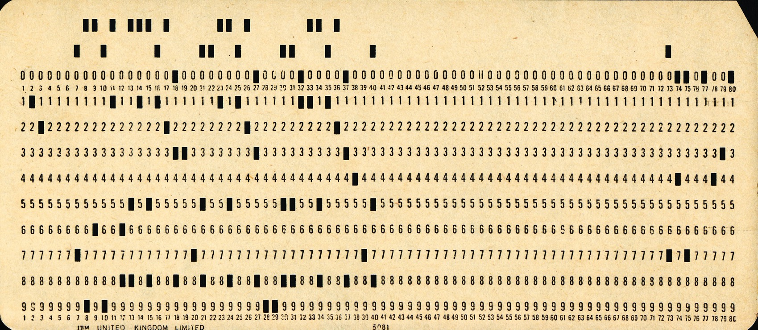
A punch card

Slide 23
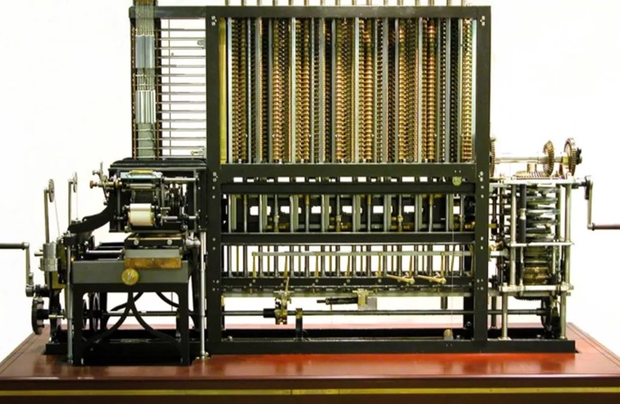
Before computers
Charles Babbage in 1823 started work on his Difference Engine. It was programmed using punch cards and could do simple calculations to 31 digits. Do to high costs, it was not built until 1991, well after his death. It weighed 15 tons and was 8 ft tall.
It used human-power to turn the gears and cranks and output the result using wheels with digits painted on.
Fun Fact: The gear technology didn’t exist to build his machine, so Babbage invented new ways of cutting gears. This incidentally advanced machinery and factories during the end industrial revolution (1760-1840).
Ada Lovelace, the first programmer, theorized how to program Babbage's Machines.
Notes:
Adapted from Robert Baker, 2018

Slide 24
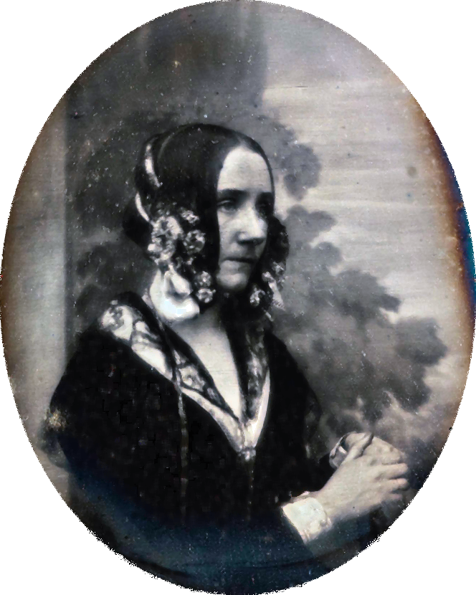
Ada Lovelace
(1815 – 1852)
Notes:
https://en.wikipedia.org/wiki/Ada_Lovelace

Slide 25
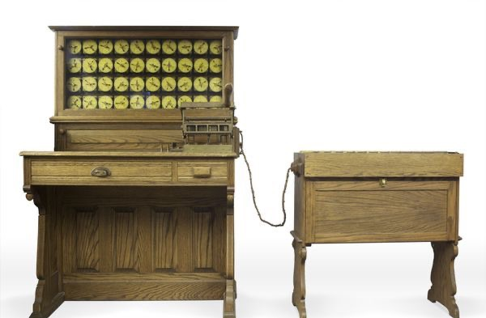
Before computers
In 1985, Herman Hollerith designed the “Electric Tabulating System”, a machine designed to take on the 1890’s Census. It was an early Scantron machine using punch cards.
The 1880’s Census took 7 years to count, so do to the growing population, the 1890’s and 1900’s Censuses would have taken more than 10 years. This would not be good.
With his machine, the 1890’s Census only took 6 weeks rather than 10 years. This proved computers were a viable solution to many previously impossible problems.
Notes:
Adapted from Robert Baker, 2018

Slide 26
Notes:
Image from Eric Silva, Hawk Mountain Council, STEM Day 2016

Slide 27
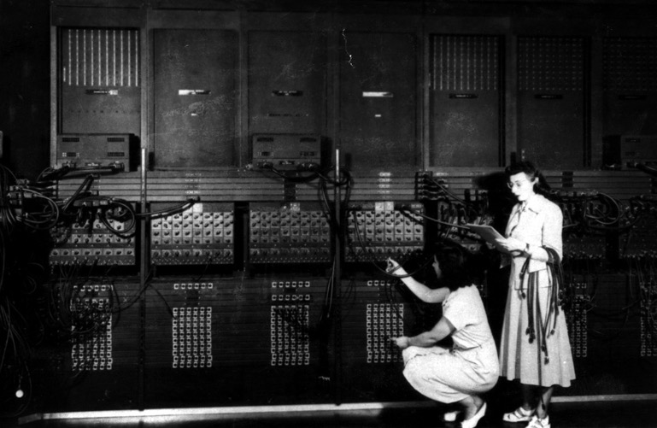
Early computers
ENIAC – Electronic Numerical Integrator And Computer (1946)
First general purpose computer
Used Base-10 instead of Binary (Base-2)
Used to calculate firing-tables for the military.
UNIVAC – UNIVersal Automatic Computer (1951)
First commercial computer
Brought computers into the public eye after it correctly predicted the “total-upset, landslide”, 1952 Presidential Election.
ENIAC 1946 – What do you notice about this photo
Notes:
Adapted from Robert Baker, 2018
What is noticeable: Women, not men, were the ones running these early computers.
This lead to many women leading computer science into the 21st century, i.e. Grace Hopper, who programed the ENIAC. She also designed COBOL. This language is still used today.

Slide 28
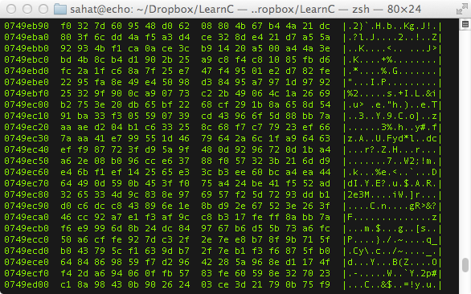
History of programming
What was the first programming language?
Binary / Machine Language (ML)
Binary / ML is really hard to read, but it can be done.
Early computers used switches and cables to accomplish this.
It is insanely fast, only limited by hardware speed.
All programming languages end up as Binary / ML at some point during execution.
Notes:
Adapted from Robert Baker, 2018
Notice that is Binary / ML is actually represented in Hex, which is just a more compact way for writing Binary.
The column of 8 numbers on the left is the hardware memory address in RAM where each line of code is stored.
The next two big columns are the actual code separated into bytes (each 2 characters is 1 byte).
The third column is the ASCII representation of the data in the previous two big columns.

Slide 30
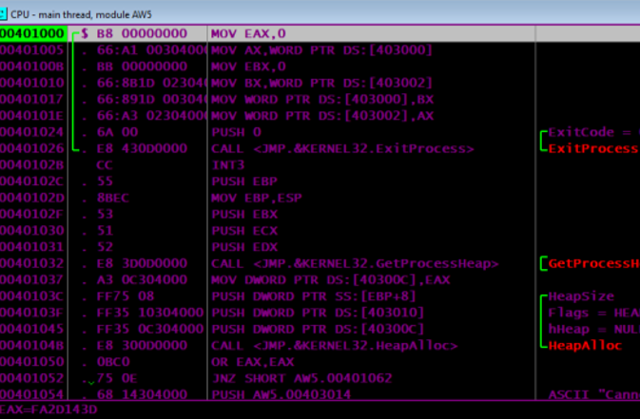
History of programming
Next came Assembly Language (ASM)
Slightly easier to read than Binary / ML
Still very fast because it maps back to Binary / ML
Very few people ‘need’ to program is ASM
There is a different Assembly Language for each CPU design, so it is not portable code.
Why is portable code good?
Notes:
Adapted from Robert Baker, 2018
This is a program I wrote for my Assembly class.
In this photo you can see the hardware memory address in the left-most column.
In the widest column is a x86-Assembly code (MOV EAX,0)
The second column from the left is the Machine Language generated from the x86-Assembly code.

Slide 31
Notes:
Image from Eric Silva, Hawk Mountain Council, STEM Day 2016

Slide 32
History of programming
Next-Generation Languages came around the 1950’s.
They allowed:
Code portability between different systems
Easier to write, read and debug code
Allowed for new concepts (i.e. functions, classes, objects, OOP)
Explored new fields (i.e. science, math, computer science, data science, business)
The first big languages were… (in order of creation)
FORTRAN, LISP, COBOL, BASIC and Pascal
Notes:
Adapted from Robert Baker, 2018
A lot of old code that was written in FORTRAN or COBOL is still in use today because it would be too expensive to rewrite it.
Also there are huge sections of code that is “dead-code”. People don’t know what it does, so they don’t touch it and it just sits there.

Slide 33
Notes:
Image from Eric Silva, Hawk Mountain Council, STEM Day 2016

Slide 34
Additional pointers
History of programming languages: https://en.wikipedia.org/wiki/History_of_programming_languages
Visual history of programming languages: https://visual.ly/community/infographic/technology/history-computer-programming
Ada Lovelace: https://en.wikipedia.org/wiki/Ada_Lovelace

Slide 35
2. History of programming
Now you can answer Requirements 2a!

Slide 36
3. Programming today

Slide 37
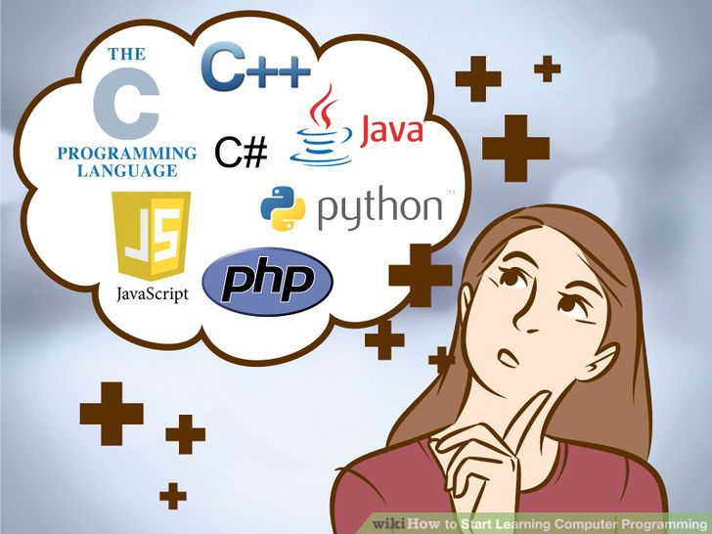

Slide 38
Programming Now
How many languages do you recognize?
C
C++
Java
JavaScript
HTML
CSS
Python
Ruby
PHP
OpenCL
SQL
MATLAB
Erlang
Ada
Objective-C
Swift
Mathematica
C#
Visual Basic
Rust
F#
R
Go
PowerShell
BASH
TypeScript
PostScript
CoffeeScript
Perl
x86-Assembly MASM
RegEx
PL/SQL
MIPS
ColdFusion
LaTeX
XML
JSON
Ladder Logic
YAML
Batch
Notes:
Adapted from Robert Baker, 2018

Slide 39
Programming Now
Why are the languages grouped into colors?
C
C++
Java
JavaScript
HTML
CSS
Python
Ruby
PHP
OpenCL
SQL
MATLAB
Erlang
Ada
Objective-C
Swift
Mathematica
C#
Visual Basic
Rust
F#
R
Go
PowerShell
BASH
TypeScript
PostScript
CoffeeScript
Perl
x86-Assembly MASM
RegEx
PL/SQL
MIPS
ColdFusion
LaTeX
XML
JSON
Ladder Logic
YAML
Batch
Notes:
Adapted from Robert Baker, 2018

Slide 40
C
C++
Java
JavaScript
HTML
CSS
Python
Ruby
PHP
OpenCL
SQL
MATLAB
Erlang
Ada
Objective-C
Swift
Mathematica
C#
Visual Basic
Rust
F#
R
Go
PowerShell
BASH
TypeScript
PostScript
CoffeeScript
Perl
x86-Assembly MASM
RegEx
PL/SQL
MIPS
ColdFusion
LaTeX
XML
JSON
Ladder Logic
YAML
Batch
The Green Languages are General Programing Languages
The Purple Languages are Scripting Languages
The Red Languages are Markup Languages
The Blue Languages are Declarative Languages
The Orange Languages are Assembly Languages
Different types of languages have different purposes.
It is important to match the type of work to the correct language to insure the best results.
Notes:
Adapted from Robert Baker, 2018

Slide 41
Programming Languages
Here are a few languages and the problems they try to tackle…
C++ – General Purpose, High Performance | ex. Game Engines, Desktop Apps (Adobe Photoshop, Chrome)
C – General Purpose, High Performance, Light Weight | ex. Linux OS, macOS, Integrated Circuits, Drivers
Java – General Purpose, Multiplatform | ex. Minecraft, Server Apps, Android Apps
C# – General Purpose, Windows Platform | ex. Unity Games, Server Apps, StackOverflow
Swift – General Purpose, iOS & macOS | ex. most apps for iPhones and macOS (replaced Objective-C)
SQL – Database Communication
JavaScript – General Web Scripting | ex. Interactive webpages, webpages that can run dynamic code
HTML – Webpage Design, Layout and Markup
CSS – Webpage Styling, Coloring, Fonts and Positioning
PHP – Web Server Code | ex. Backend Web Dev., Web Content Management Systems (i.e. WordPress)
TypeScript – Stricter Superset of JS that transpiles into JS |ex. Large JavaScript Apps
XML – Human and Machine readable file format for data sharing between apps
Notes:
Adapted from Robert Baker, 2018

Slide 42
Programming Examples
Hello World
C++
#include <iostream> int main(int argc, char *argv[])
{
char myString[] = “Hello World!”;
std::cout << myString << std::endl;
return 0;
}
Java
class HelloWorld {
private String myString = "Hello World!";
public static void main(String args[]) {
System.out.println(myString);
}
}
Notice how different languages can look very different even when they are doing the same task.
Notice also how the bracing ( i.e. “{}”) style is different between languages.
Notes:
Adapted from Robert Baker, 2018
The reason for the different colors here is due to syntax highlighting.
Syntax Highlighting is a feature in programming apps where it automatically colors different parts of the code to increase readability.

Slide 43
Notes:
Blue insert by Nate Swedberg

Slide 44
Notes:
Blue insert by Nate Swedberg

Slide 45
Notes:
Blue insert by Nate Swedberg

Slide 46
Programming Examples
Hello World
C#
using System;
using System.Collections.Generic;
using System.Text;
namespace ConsoleApplication1
{
class HelloWorld
{
String myString = "Hello, world!";
static void Main(string[] args)
{
Console.WriteLine(myString);
}
}
}
X86 Assembly
.486
.model flat, stdcall
.stack 100h
option casemap :none
ExitProcess PROTO Near32 stdcall, dwExitCode:dword
putch PROTO Near32 stdcall, bChar:byte; .data
strMyString byte "Hello World",0
.code
main PROC
mov ecx, LENGTHOF strMyString
mov esi, OFFSET strMyString
L1:
invoke putch, byte PTR esi
inc esi
loop L1
invoke ExitProcess,0
main ENDP
END main
Notes:
Adapted from Robert Baker, 2018
The reason for the different colors here is due to syntax highlighting.
Syntax Highlighting is a feature in programming apps where it automatically colors different parts of the code to increase readability.

Slide 47
Programming Examples
Hello World
JavaScript
myString = "Hello World!";
console.log(myString);
Python
myString = 'Hello World!'
print(myString)
Notice how different languages can look very different even when they are doing the same task.
Notes:
Adapted from Robert Baker, 2018
The reason for the different colors here is due to syntax highlighting.
Syntax Highlighting is a feature in programming apps where it automatically colors different parts of the code to increase readability.

Slide 48
Notes:
Blue insert by Nate Swedberg

Slide 49
Programming Language Types
Languages can be split into a three different levels..
High-Level (ex. Python, Ruby, JavaScript, Java, SQL)
C-Level (ex. C, C++, Rust)
Low-Level (x86 Assembly, Machine Language)
Notes:
Adapted from Robert Baker, 2018

Slide 50
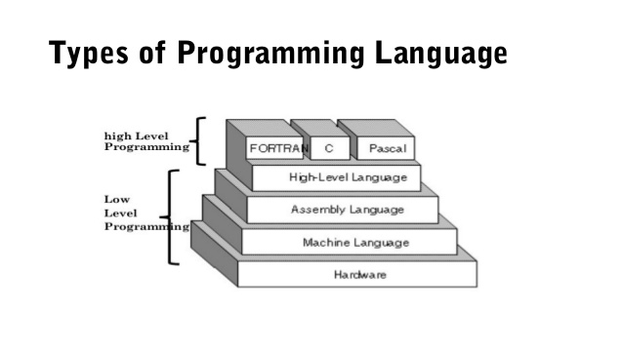
Programming Language Types
Why would you use a High-Level, Low-Level or C-Level language?
Low Level
Pros: Fast Execution, No Overhead, Single Platform, Compiled
Cons: Hard to read, write, debug, and maintain
Examples: ML, MASM, TASM, NASM, MIPS
High-Level
Pros: Easier to read, write, debug, and maintain, Multi-Platform, Compiled or Interpreted
Cons: Slower than Low-Level, not as much control over hardware
Examples: Python, Ladder-Logic, JavaScript, Java, SQL
C-Level
Best of both worlds, Compiled
Good control over hardware with ease of writing.
Examples: C, C++, Rust, FORTRAN, PASCAL
Notice: Java, Python, etc. are one level higher than FORTAN, C and PASCAL
Notes:
Adapted from Robert Baker, 2018

Slide 51
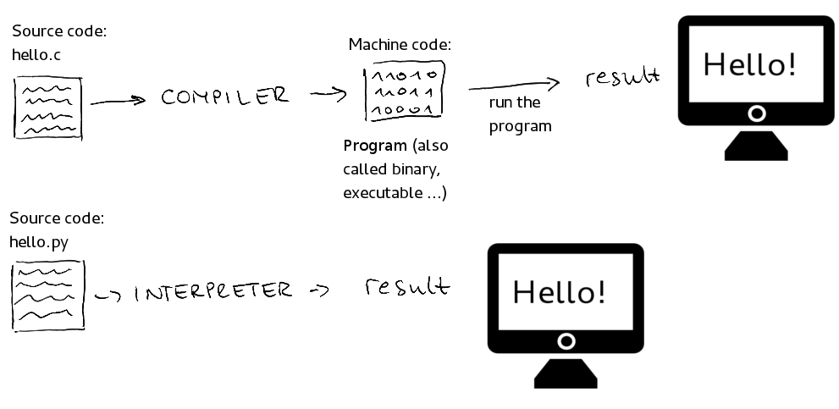
Programming Language Types
This photo illiterates the difference between compiled and interpreted languages…
Use your computers to make a list of 3 compiled languages and 3 interpreted languages.
Where would you use a compiled languages vs an interpreted language?
Done every time
Done once
Done every time
Notes:
Adapted from Robert Baker, 2018

Slide 52
Notes:
Blue insert by Nate Swedberg

Slide 53
Programmed Devices
Our lives are filled with so many programmed devices, you many not even notice…
What are somethings around your house that are programmed?
Smart TVs, Smart Door Bells
Xbox, PlayStation, Wii, Ms. Pacman
Microwave, Wi-Fi Router (these two are the same thing)
Etc..
What language do you think these were programmed in?
Notes:
Adapted from Robert Baker, 2018

Slide 54
Additional pointers
100 Of The Most Popular Programming Languages Explained In Minutes: https://www.whoishostingthis.com/resources/programming/
Code academy: www.codeacademy.com
Code.org: www.code.org
Learn Python: www.learnpython.org
Learn C++: www.learncpp.com
Scratch: scratch.mit.edu
Killer PHP: www.killerphp.com
W3 Schools: www.w3schools.com

Slide 55
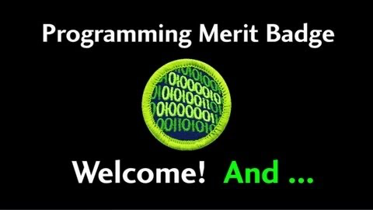

Slide 56
3. Programming today
Now you can answer Requirements 3a and 3b!

Slide 57
4. Intellectual property

Slide 58
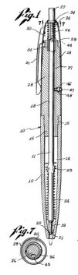
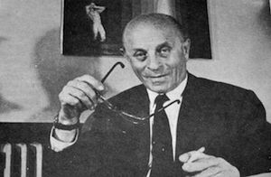
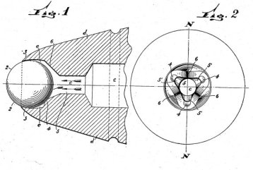
László Jozsef Bíró,
the inventor of the ballpoint pen
U.S. Patent No. 2390636:
“Writing Instrument.”
U.S. Patent No. 2734484:
“Ball Point Pen.”
Notes:
BIC is a physical item – it’s a ballpoint, invented by …
Interesting idea: before writing with a “ballpoint pen”, we were writing with a “fountain pen”
Full story: https://www.ipwatchdog.com/2014/12/10/the-evolution-of-modern-ballpoint-pen-a-patent-history/id=52550/

Slide 59
Intellectual Property
Notes:
IP = creation that cannot be touched or held, such as ideas, plans and designs.

Slide 60
Copyright protection (©)
Protects a particular expression of an idea that the author created
Automatic + registration with the U.S. Copyright Office (~ $85)
Intellectual Property

Slide 61
Copyright protection (©)
Protects expression of idea
The Merit Badge Book is © BSA
Powerpoints, game art, specific code, …
Intellectual Property

Slide 62
Copyright protection (©)
Protects a particular expression of an idea that the author created
Automatic + registration with the U.S. Copyright Office (~ $85)
Intellectual Property
Patents
Protects useful innovative processes or methods, machines, manufactured items, or “compositions of matter”.
Must be applied for (USPTO)
Need to describe inner workings

Slide 63
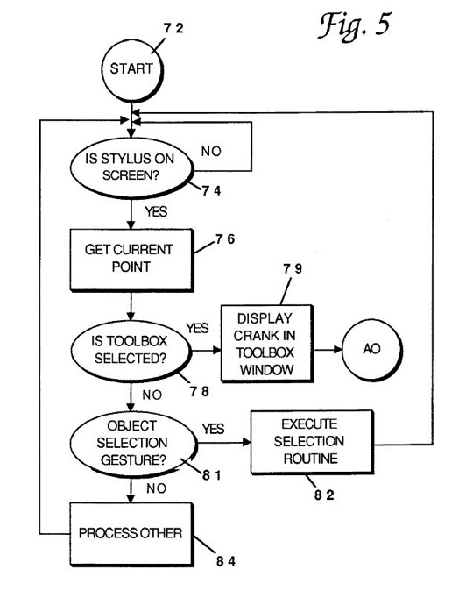
Copyright protection (©)
Protects a particular expression of an idea that the author created
Automatic + registration with the U.S. Copyright Office (~ $85)
Intellectual Property
Patents
Protects useful and innovative processes or methods, machines, manufactured items, …
A new and revolutionary math algorithm used in an app

Slide 64
Trademark (™)
Copyright protection (©)
Protects a word, phrase, symbol, sound or color that identifies or distinguishes the source of a particular product or service
Protects a particular expression of an idea that the author created
Automatic + registration with the U.S. Copyright Office (~ $85)
Intellectual Property
Patents
Protects useful innovative processes or methods, machines, manufactured items, or “compositions of matter”.
Must be applied for (USPTO)
Need to describe inner workings

Slide 65


Trademark (™)
Copyright protection (©)
Protects a word, phrase, symbol, sound or color that identifies or distinguishes the source of a particular product or service
Protects a particular expression of an idea that the author created
Automatic + registration with the U.S. Copyright Office (~ $85)
Intellectual Property
Patents
Protects useful innovative processes or methods, machines, manufactured items, or “compositions of matter”.
Must be applied for (USPTO)
Need to describe inner workings
Notes:
Girl Scouts vs. Boys Scouts: https://www.ipwatchdog.com/2018/12/27/girl-scouts-file-trademark-complaint-against-rival-boy-scouts/id=104458/
The crux of the Girl Scouts’ claims is that their organization owns the exclusive right to use the trademark SCOUT (and variations) for enrichment programing for girls, and that the Boy Scouts’ use of the terms in connection with enrichment programming for girls violates the Girl Scouts organization’s trademark rights.
Flappy Bird: https://www.kaufholdpatentgroup.com/the-legal-issues-standing-in-the-way-of-a-flappy-bird-return/

Slide 66
Trademark (™)
Copyright protection (©)
Protects a word, phrase, symbol, soud or color that identifies or distinguishes the source of a particular product or service
Protects a particular expression of an idea that the author created
Automatic + registration with the U.S. Copyright Office (~ $85)
Intellectual Property
Patents
Trade secrets
Protects useful innovative processes or methods, machines, manufactured items, or “compositions of matter”.
Must be applied for (USPTO)
Need to describe inner workings
Protects valuable information be not disclosing it to anyone, enforced by a contract called a NDA (Non Disclosure Agreement)

Slide 67
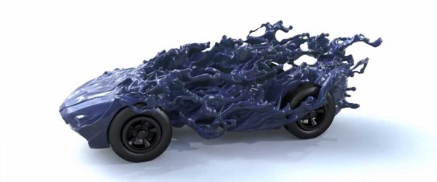
Trademark (™)
Copyright protection (©)
Protects a word, phrase, symbol, soud or color that identifies or distinguishes the source of a particular product or service
Protects a particular expression of an idea that the author created
Automatic + registration with the U.S. Copyright Office (~ $85)
Intellectual Property
Patents
Trade secrets
Protects useful innovative processes or methods, machines, manufactured items, or “compositions of matter”.
Must be applied for (USPTO)
Need to describe inner workings
Protects valuable information be not disclosing it to anyone, enforced by a contract called a NDA
What info Facebook collects, PWD cars, …

Slide 68

Selling your software
Freeware - 100% free to use, not necessarily free to be modified or distributed
Shareware - free to download and use but asked for donations (i.e. Ad-Block). Not free to modify or distribute
Demo - A free trial version of the program, may not have all the features enabled. Not free to modify or distribute
Closed Source - the code is NOT exposed to the public and cannot be edited or distributed (doesn’t mean free)
Open Source - the code is exposed to the public and can be modified or distributed, may be limits or restrictions (doesn’t mean free)
Public Domain – There is absolutely no ownership such as copyright, trademark, or patent. Software in the public domain can be modified, distributed, or sold even without any attribution by anyone

Slide 69


Software piracy
Notes:
FBI Anti-Piracy Warning Seal: https://www.fbi.gov/investigate/white-collar-crime/piracy-ip-theft/fbi-anti-piracy-warning-seal
Blue insert by Nate Swedberg

Slide 70
Owning or licensing?
Do I own a copy of PowerPoint?
Do I own a copy of Google Chrome?
Do I own a copy of an App I built?
What is the difference between owning and licensing?
Owning means you have every right to do what you want with the software or code. Most people do not own software.
Licensing is where you “buy or get permission” to use the software, often subscription based.

Slide 71
Additional pointers
What is Open Source? https://opensource.com/resources/what-open-source
The Open Source Initiative: https://opensource.org/
Intellectual Property: https://en.wikipedia.org/wiki/Intellectual_property
Intellectual Property Theft/Piracy: https://www.fbi.gov/investigate/white-collar-crime/piracy-ip-theft

Slide 72
4. Intellectual property
Now you can answer Requirements 4a, 4b and 4c!

Slide 73
6. Careers

Slide 74
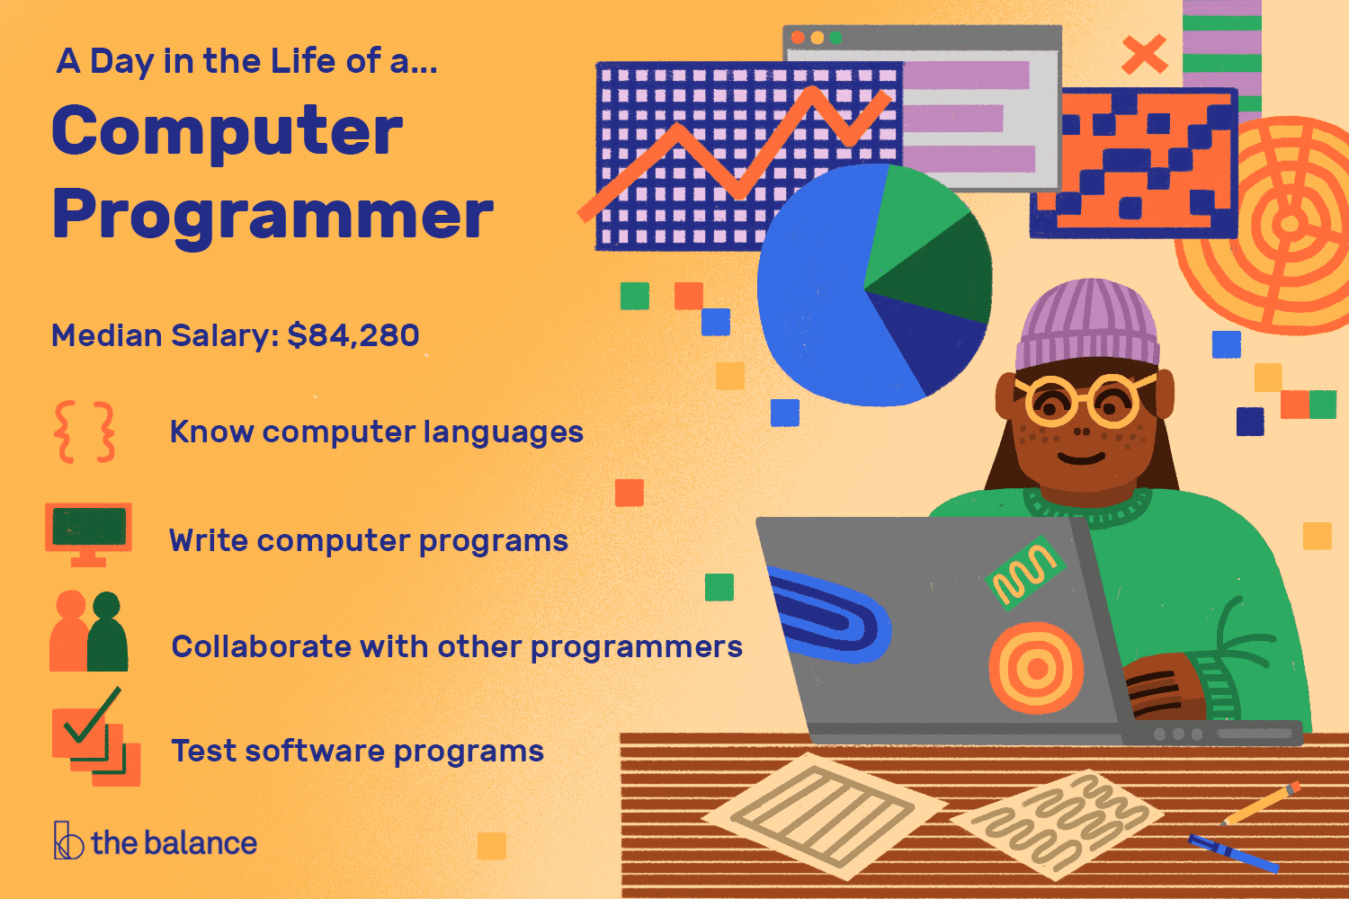
Notes:
There are approximately 1.2 million programmers and software developers in the US.

Slide 75

Where is programming used?
(A: Everywhere!)

Slide 76
Where is programming used?
Mobile devices
Business applications
Factory automation
Robotics
Internet
Animation
Entertainment
Outdoor
Engineering
Science
Automobiles
Traffic control
Information security
Gadgets
Medical devices
Healthcare
…
Can you find examples around you?

Slide 77
Additional pointers
Examples of programs for different industries (Boys Life): https://boyslife.org/merit-badges/programming-merit-badge/
How to become a computer programmer? (Learn How To Become): https://www.learnhowtobecome.org/computer-programmer/
9 Programming Careers for Coding Connoisseurs (Rasmussen College): https://www.rasmussen.edu/degrees/technology/blog/programming-careers-for-coding-connoisseurs/
What Does a Computer Programmer Do? (The Balance Career): https://www.thebalancecareers.com/what-does-a-computer-programmer-do-525996
10 signs a career in coding and software development might be right for you (The Guardian): https://www.theguardian.com/careers/ten-signs-career-coding-software-development-right-for-you

Slide 78
6. Careers
Now you can answer Requirements 6!

Slide 79
What’s next?
Check the requirements (https://filestore.scouting.org/filestore/Merit_Badge_ReqandRes/Programming.pdf)
Use the worksheet to track progress (https://boyslifeorg.files.wordpress.com/2019/06/programming.pdf)
If you need anything, tell me. I’m happy to explain, re-explain, or debug with you!
When you are ready, let’s discuss! The easiest is 20-30 minutes before a Troop meeting

